Slide 1
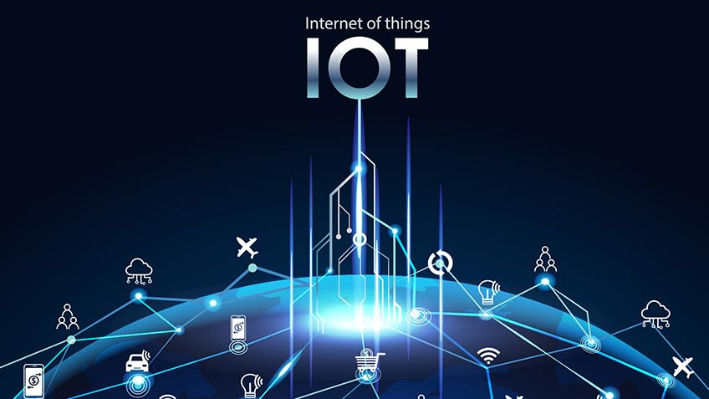
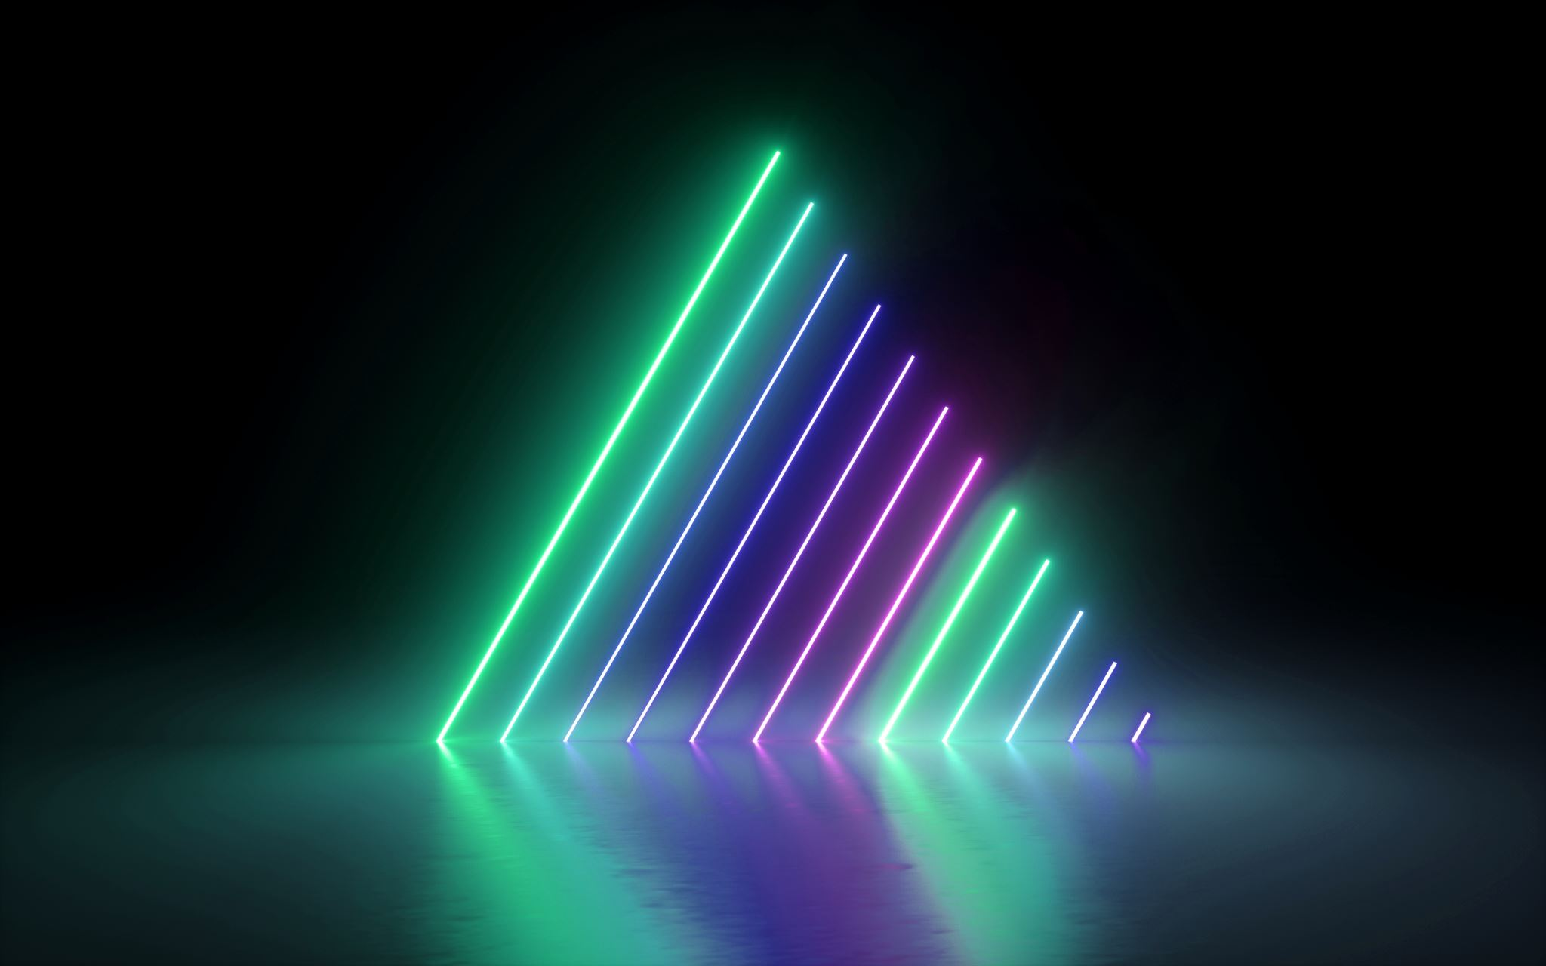

Date: 02.02.2023
Introduction to IoT
Narsaiah Putta
Asst. Professor
VCE

Slide 2
Table Of Content
History of IoT
IoT Definition
How IoT works?
What is an example of an Internet of Things device?
IoT benefits to organizations
Why Is Internet of Things (IoT) so important?
IoT Applications
Challenges of Internet of Things (IoT)
Advantages
Disadvantages
Characteristics of IoT

Slide 3
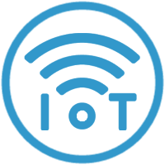
History of IOT
1999- The term "Internet of Things" was used by Kevin Ashton during his work at P&G which became widely accepted
2004 - The term was mentioned in famous publications like the Guardian, Boston Globe, and Scientific American
2005-UN's International Telecommunications Union (ITU) published its first report on this topic.
2008- The Internet of Things was born
2011- Gartner, the market research company, include "The Internet of Things" technology in their research
2022 – 1.3 Billion devices are connected thru IoT platform
22 devices were used at every house by 2022

Slide 4
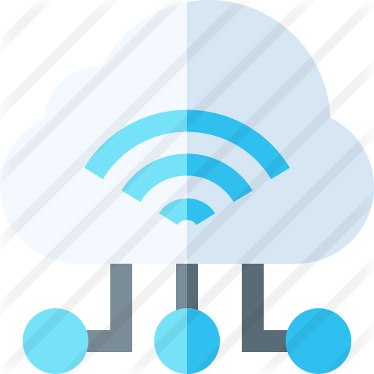
IoT Definition
“The Internet of Things (IoT) is a system of interrelated computing devices, mechanical and digital machines, objects, animals or people that are provided with unique identifiers and the ability to transfer data over a network without requiring human-to-human or human-to-computer interaction.”

Slide 5
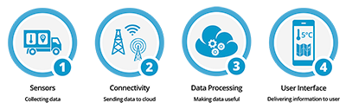
How IoT works?
1) Sensors/Devices
2) Connectivity
3) Data Processing
4) User Interface

Slide 6

1) Sensors/Devices
Sensors or devices are a key component that helps you to collect live data from the surrounding environment.
All this data may have various levels of complexities.
It could be a simple temperature monitoring sensor, or it may be in the form of the video feed.

Slide 7
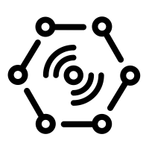
2) Connectivity
All the collected data is sent to a cloud infrastructure.
The sensors should be connected to the cloud using various mediums of communications.
These communication mediums include mobile or satellite networks, Bluetooth, WI-FI, LoRa, WAN, etc.

Slide 8

3) Data Processing
Once that data is collected, and it gets to the cloud, the software performs processing on the gathered data.
This process can be just checking the temperature, reading on devices like AC or heaters.
However, it can sometimes also be very complex like identifying objects, using computer vision on video.

Slide 9
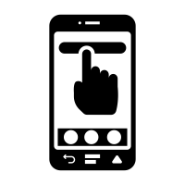
4)User Interface
The information needs to be available to the end-user in some way which can be achieved by triggering alarms on their phones or sending them notification through email or text message.
The user sometimes might need an interface which actively checks their IoT system.
For example, the user has a camera installed in his home. He wants to access video recording and all the feeds with the help of a web server.

Slide 10
What is an example of an Internet of Things device?
A lightbulb that can be switched on using a smartphone app is an IoT device, as is a motion sensor or a smart thermostat in your office or a connected streetlight.
An IoT device could be as fluffy as a child's toy or as serious as a driverless truck.
Some larger objects may themselves be filled with many smaller IoT components, such as a jet engine that's now filled with thousands of sensors collecting and transmitting data back to make sure it is operating efficiently.

Slide 11
IoT benefits to organizations
monitor their overall business processes;
improve the customer experience (CX);
save time and money;
enhance employee productivity;
integrate and adapt business models;
make better business decisions; and
generate more revenue.

Slide 12
Why Is Internet of Things (IoT) so important?
Over the past few years, IoT has become one of the most important technologies of the 21st century.
Now that we can connect everyday objects—kitchen appliances, cars, thermostats, baby monitors—to the internet via embedded devices, seamless communication is possible between people, processes, and things.
By means of low-cost computing, the cloud, big data, analytics, and mobile technologies, physical things can share and collect data with minimal human intervention.

Slide 13
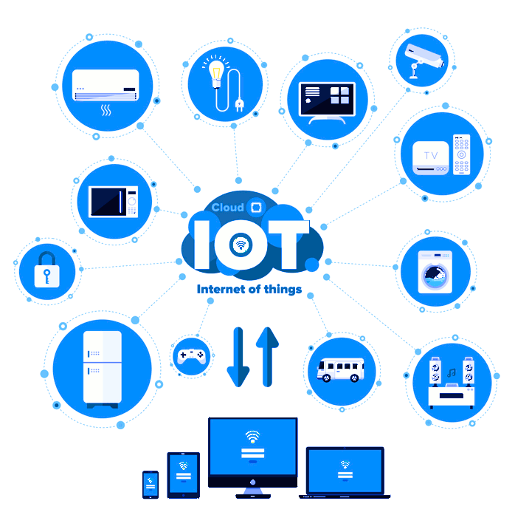
IoT Applications
Smart Thermostats
Connected Cars
Activity Trackers
Parking Sensors
Connect Health
Smart City

Slide 14
Challenges of Internet of Things (IoT)
Insufficient testing and updating
Concern regarding data security and privacy
Software complexity
Data volumes and interpretation
Integration with AI and automation
Devices require a constant power supply which is difficult
Interaction and short-range communication

Slide 15
Advantages of IoT
Ability to access information from anywhere at any time on any device;
Improved communication between connected electronic devices;
Transferring data packets over a connected network saving time and money; and
Automating tasks helping to improve the quality of a business's services and reducing the need for human intervention.

Slide 16
Disadvantages IoT
As the number of connected devices increases and more information is shared between devices, the potential that a hacker could steal confidential information also increases.
Enterprises may eventually have to deal with massive numbers -- maybe even millions -- of IoT devices, and collecting and managing the data from all those devices will be challenging.
If there's a bug in the system, it's likely that every connected device will become corrupted.
Since there's no international standard of compatibility for IoT, it's difficult for devices from different manufacturers to communicate with each other.

Slide 17
Characteristics of IoT
Unique Identity
Dynamic Nature
Self-Adopting
Self Configuring
Heterogeneity
Integrated to information network
Scalability
Safety

Slide 18

Thank You !!!

